Slide 1


SAS PROJECT: ANALYZING TRENDS IN APPRENTICESHIP ENROLLMENT
By Aryan Kukreja and Chris Chance | Dr. Sacha Noukhovitch | Earl Haig Secondary School, North York, ON, CA

Slide 2


The Big Question: Why are Apprenticeship Completion Rates in Ontario so Low?
Notes:
This is the question that your experiment answers

Slide 3
Overview of the Summative Project
Write code for importing and analyzing datasets in SAS Studio
Analyze 4 major data sets for noticeable patterns
Note down patterns as substantial evidence in table/charts
Form a hypothesis prior to analysis
Analyze data relevant to hypothesis thoroughly
Record findings
Use evidence to support/oppose hypothesis

Slide 4

Major Tools and Research Sources Used
Major sources of research:
4 Data Sets:
RAIS_dataset.csv
OCTAA_dataset.csv
JVWS_dataset.csv
APP_OD_dataset.csv
2016 Auditor General’s Report
Tools used:
SAS Studio – For analyzing data sets
Notes:
Summarize your research in three to five points.

Slide 5

Discussion Questions: Prior to Formulating Hypothesis
Simple questions answered to assist in formulating hypothesis (taken from problem statement sheet)
Number of apprentices in Ontario
What is the mean age of participants in the program?
What is the most popular trade?
Which trade has the highest rate of completion?

Slide 6
How many Apprentices are there in Ontario?
 | 2011 | 2012 | 2013 | 2014 | 2015
No Direct Qualification | 0 | 0 | 0 | 0 | 0
Continuing Program | 134,676 | 143,498 | 121,788 | 125,231 | 94,767
Completed Program | 10,158 | 11,064 | 17,706 | 11,619 | 9,915
Discontinued Program | 8,470 | 9,424 | 32,666 | 7555 | 28,406
Total Individuals | 153,767 | 164,426 | 172,559 | 144,827 | 133,449
Total Without Discontinued | 144,834 | 154,562 | 139,494 | 136,850 | 104,682

Slide 7
What is the Mean Age of Participants?
Age data did not vary enough to be able to form a conclusion
Data points were joined too closely together
Mean Age of Individual in Sampled Record
2011 | 30.93
2012 | 31.14
2013 | 31.56
2014 | 31.61
2015 | 31.52

Slide 8
Which Trades are the Most Popular and Which have the Highest Completion Rates?
Most Popular Trade by Persons Continuing/Completed Program
Year | Name of Trade | Total Completed | Total Continuing | Total
2011 | Automotive Service Technician | 1,212 | 10,644 | 11,624
2012 | Automotive Service Technician | 1,338 | 11,215 | 12,201
2013 | Electrician - Construction and Maintenance | 2,581 | 9,265 | 10,230
2014 | Automotive Service Technician | 1,221 | 9,472 | 10,326
2015 | Electrician - Construction and Maintenance | 1,314 | 7,258 | 9,258
Highest Apprenticeship Completion Rates by Year
Year | Name of Apprenticeship | % Completion Rate
2011 | Construction Craft Worker | 77.80%
2012 | Electrician (Signal Maintenance) (TTC) and Light Rail Overhead Contact Systems Line-Person | 50.00%
2013 | Ironworker - Structural and Ornamental | 66.70%
2014 | Information Technology - Contact Centre Technical Support Agent | 50.00%
2015 | Tractor-Trailer Commercial Driver | 40.00%

Slide 9
“ Many apprentices may be dropping out of their particular trade training because their hourly wage relative to the number of hours they put in every week may not be rewarding enough to them, or they fear that the job market for their field is shrinking, which could have them jobless. ” - Aryan Kukreja and Chris Chance
Hypothesis
Notes:
Establish hypothesis before you begin the experiment. This should be your best educated guess based on your research.

Slide 10
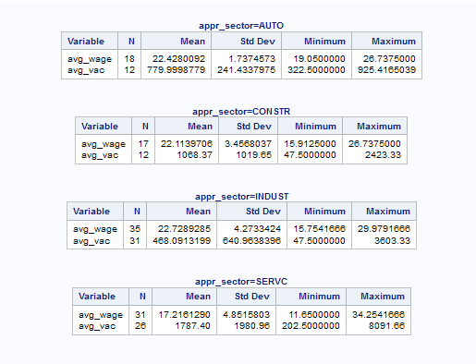
Hypothesis Verification: Analyzing Wage Data
Service sector (SERV) has lowest mean pay, but has the highest mean number of jobs
Industrial Sector (INDUST) has highest mean pay but lowest mean number of jobs
Mean pay for Construction Sector (CONSTR) and Automotive Sector (AUTO) almost matches the Industrial Sector
CONSTR and AUTO Sectors have a fairly high number of jobs compared to INDUST sector
Pay-scale is fairly higher for AUTO and CONSTR compared to SERVC.

Slide 11
Data/Observations
Low number of jobs in Industrial Sector make it unattractive for apprenticeship trainees
Although Service Sector has highest mean # of jobs, lowest mean wage makes it unattractive
Construction Sector and Automotive Sector have healthy number of jobs, accompanied with a generous salary
Recall most popular trade and trade with highest rate of completion were in Automotive/Construction Sector

Slide 12
Conclusion
Hypothesis is verified:
Apprentices-in-training quit training after understanding job scenario for their trade is not favorable
Major factors of choosing trade depends on job scenario, and pay scales for that trade
Most preferred trade from Industrial Sector only had a completion rate of 40%
No trade from service sector made it to most popular/rate of highest completion trade list
Therefore, job prospects and wages play role in dropout rates of apprentices from their trade

Slide 13

Additional Notes
Other major factors could also exist
These factors not explored in project
Major factors:
Gender Gap issues
Number of sponsors
Minor factors:
Work-Hours difference
External Factors:
Changes to law body/regulation system

Slide 14
Works Cited
"Manufacturing." Statcan.gc.ca. Goverment of Canada, 07 Oct. 2016. Web. 30 May 2017.
"2016 Auditor General Annual Report." 2016 Annual Report 1 (2016): 240-70. Auditor.on.ca. The Provincial Government of Ontario. Web. 30 May 2017.
The 4 datasets provided by the Ministry of Advanced Education ad Skills Development (MAESD).

